Slide 1
FY21 PROJECTED PROFITABILITY ANALYSIS
College of Arts and Sciences
LOYOLA UNIVERSITY, NEW ORLEANS

Slide 2
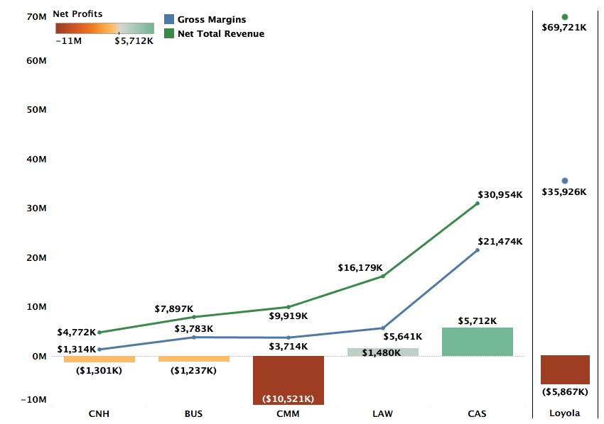
Profitability by College FY21 Projections

Slide 3
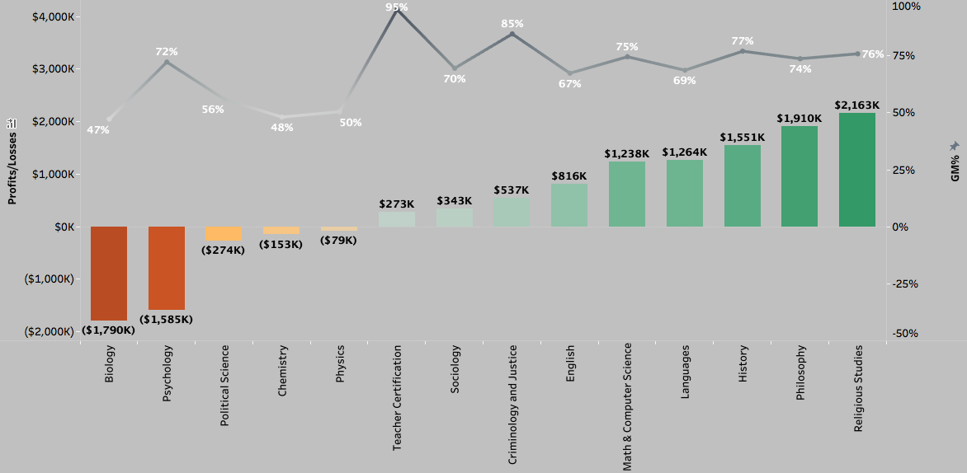
Profitability and GM% by Department (FY21 Projections)
Excluding Environment

Slide 4
DEFINITIONS
Total Revenue (TR): TR includes revenue for courses taught by the faculty of a department across all three terms, distributed revenue for courses that do not belong to a specific department, and distribution of revenues from courses of programs like Study Abroad that do not have any assigned faculty.
Avg. TR per credit (FY20) for Fall and Spring semesters is $577
Gross Margins (GM): GM = TR – Direct Costs. Direct costs include salaries, operating costs, and fringe benefits.
Avg. GM% for FY20 = 54%
Profitability = GM – Indirect Costs + Indirect Revenues. Indirect costs refer to administration costs, auxiliary costs, or college level costs distributed over departments of the specific college. Indirect revenues include auxiliary revenues, dorm revenues, and revenue from other sources.

Slide 5
Methodology FY21 Projections
FY21 Revenue Projections: Revenue projections are based on Fall 2020 enrollments and projected Spring retention rate. FY20 summer revenues are used as proxy for the FY21 summer term.
Direct Costs: Direct costs include salaries and operating costs from department budgets. FY20 fringe benefits are used as a proxy for FY21 fringe benefits.
Indirect Costs: Indirect costs in FY20 and FY21 have been higher than previous years and is reflected in department-level profitability. FY21 is also estimated to bring in lower Auxiliary revenues.

Slide 6
DEPARTMENTS WITH WORSENING FINANCIAL PERFORMANCE

Slide 7

Psychology
Although Psychology has low direct costs yielding it a 72% GM, it struggles with profitability primarily due the high level of indirect costs that are allocated to the department based on student enrollment.
Their TR/Credit is only $516 in FY19 and $509 in FY20 compared to the university average of $594 and $577 in both years respectively.

Slide 8
Biology
With slightly increasing TR and GM, the increase in projected losses for FY21 are driven by higher auxiliary costs and lower auxiliary revenues.
However, the structural problems of high discount rates from FY19 remain as its 47% GM fails to cover its share of overhead.
Their TR/Credit is only $491 in FY19 and $462 in FY20 compared to the university average of $594 and $577 in both years respectively.

Slide 9
DEPARTMENTS WITH IMPROVING FINANCIAL PERFORMANCE

Slide 10
Chemistry
After a drop in GM in FY20, Chemistry’s GM is projected to improve from 35% in FY20 to 48% in FY21 due to higher enrollment better countering its higher fixed direct costs.
However, university-wide structural issues pertaining to high discount rates remain a challenge to achieving profitability.

Slide 11
Political Science
GM has improved from 50% in FY20 to 56% in FY21 driven mainly by higher enrollment and revenues as direct costs have stayed largely constant.
Structural issues with high discount rates across the university continue to ail the department. Lower discount rates will help the department pull in revenue proportionate with its size in terms of enrollment.

Slide 12
PROFITABLE DEPARTMENTS

Slide 13
Physics
Physics’ GM has improved from 35% in FY19 to projected 50% in FY21.
However, the revenues have declined slightly from FY19.
The projected loss in FY21 is driven mainly by the lower indirect revenues and higher indirect costs because of COVID-19.

Slide 14
Sociology and Teacher Certification
Sociology
Teacher Certification

Slide 15
Criminology & Justice and English
Criminology & Justice
English

Slide 16
Math & Computer Science and Languages
Math & Computer Science
Languages

Slide 17
History and Philosophy
History
Philosophy

Slide 18
Religious Studies

Slide 19
Appendix (FY19 and FY20)

Slide 20
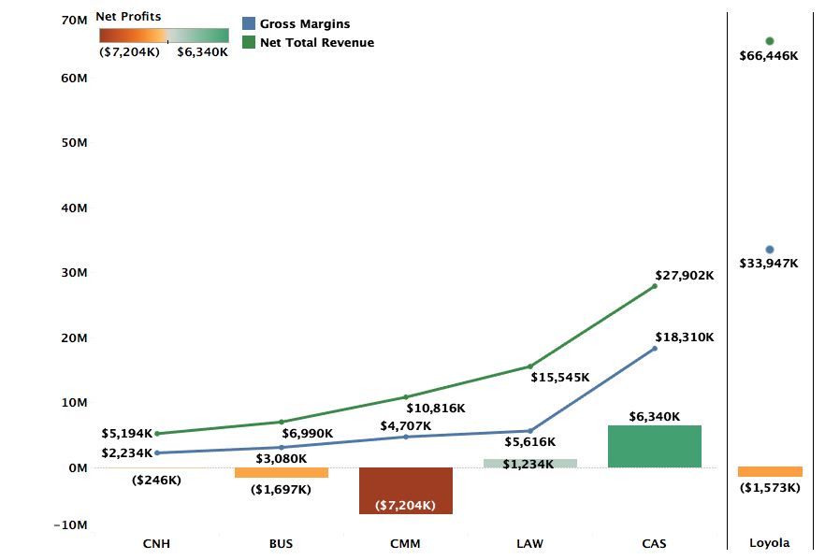
Profitability by College FY20 Actuals

Slide 21
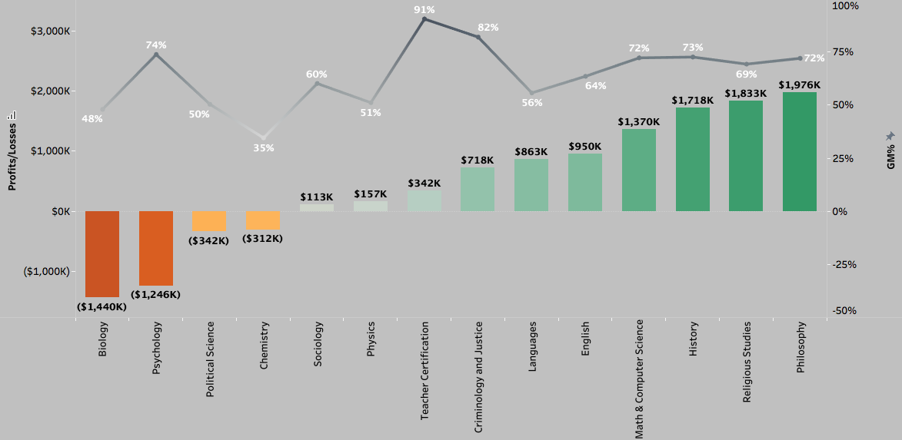
Profitability and GM% by Department (FY20 Actuals)
Excluding Environment

Slide 22
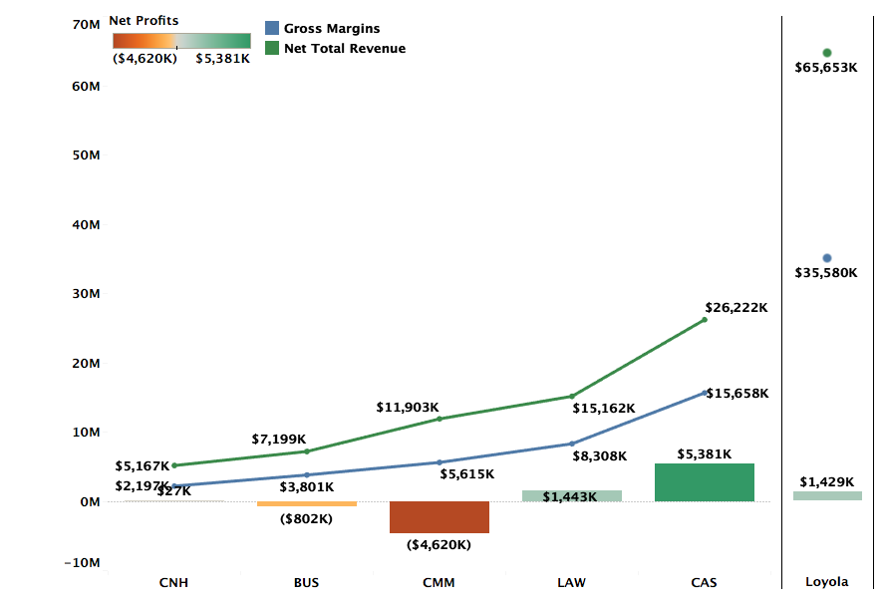
Profitability by College FY19 Actuals

Slide 23
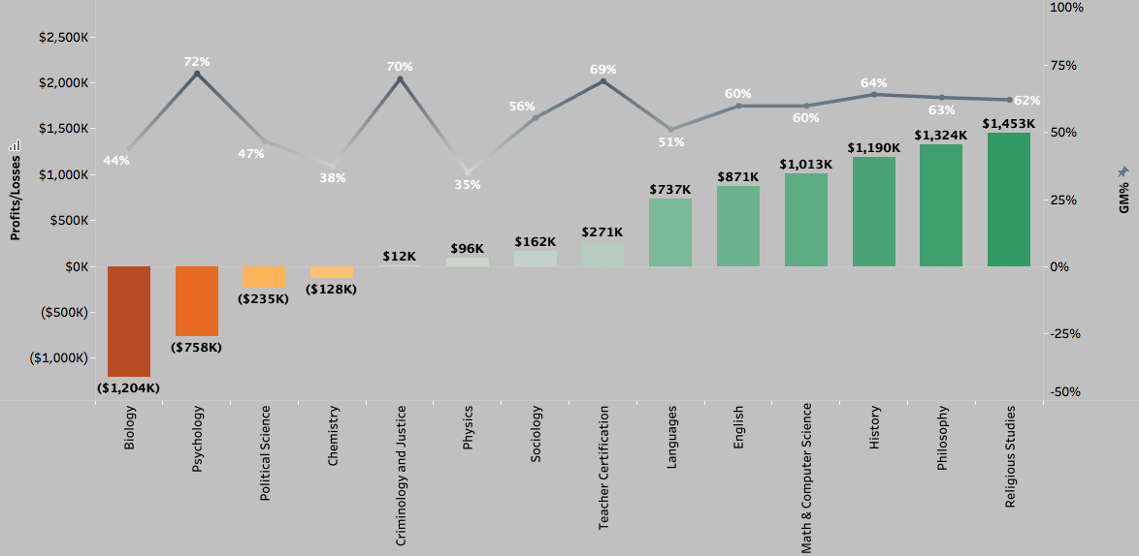
Profitability and GM% by Department (FY19 Actuals)
Excluding Environment

